Slide 1



Climate Change Prediction App
(A Machine Learning & Deep Learning Based Prediction System)
By
RAJENDRAPRASATH M

Slide 2

Learning Objectives
To design an AI-powered system for predicting key climate parameters.
To use ANN, LSTM, GRU, and RNN models for time-series predictions.
To develop a user-friendly web interface for input and displaying results.
To convert raw model predictions into human-readable weather summaries.
GOAL
Source :
www.freepik.com/

Slide 3
Tools and Technology used
Programming Language:Python
Libraries & Frameworks:
Data Handling & Analysis: Pandas, NumPy
Visualization: Matplotlib, Seaborn, Plotly
Machine Learning / Deep Learning: Scikit-learn, TensorFlow / Keras
Models Implemented: LSTM, GRU, ANN (for time-series climate prediction)
Data Sources: NASA GISTEMP, NOAA Climate Data, Kaggle Climate Datasets
Preprocessing Techniques: Handling missing values, normalization, time-series formatting
Training & Evaluation: Train-test split, evaluated using RMSE and MAE metrics
Backend: Python Flask (serving predictions)
Frontend: HTML, CSS, JavaScript (Fetch API) for user input & results display
Visualization / Reporting: Trend visualization using Matplotlib, Seaborn, Plotly

Slide 4
Methodology
Data Collection & Preprocessing
Historical climate data cleaned and normalized.
Model Training
ANN for static prediction, LSTM/GRU/RNN for time-series data.
Deployment
Flask backend serving predictions.
Frontend
HTML + JS form, fetch API to communicate with backend.
Textual Interpretation
Mapping predictions to categories like “Cold,” “Hot,” “Breezy.”

Slide 5
Problem Statement:
Climate variability and extreme weather events have increased in frequency and intensity, driven largely by climate change. Traditional statistical models often fall short in capturing the complex, nonlinear, and temporal nature of climate data. Accurate prediction is essential for mitigation strategies and early warning systems, but current tools lack adaptability and predictive robustness. Hence, there's a pressing need for a system that can process vast environmental datasets and provide reliable climate forecasts.

Slide 6
Solution:
Trained multiple deep learning models (ANN, LSTM, GRU, RNN,Linear Regression) on climate data.
Created a Flask-based backend to load models dynamically and predict values.
Designed a responsive frontend for user input of climate features.
Implemented a text interpretation module to convert raw predictions into human-readable summaries (e.g., “Hot and Humid with Light Rain”).

Slide 7
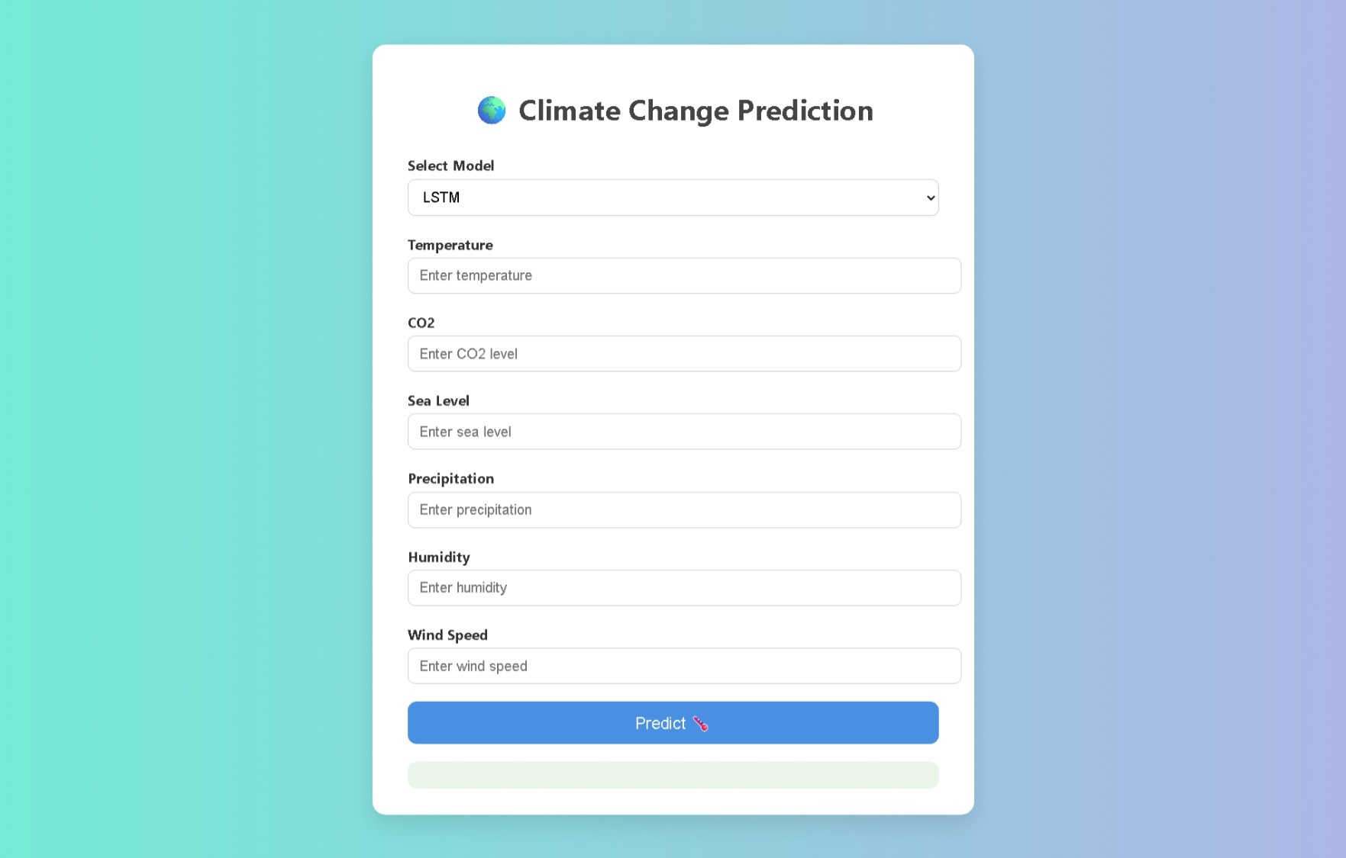
Screenshot of Output:

Slide 8
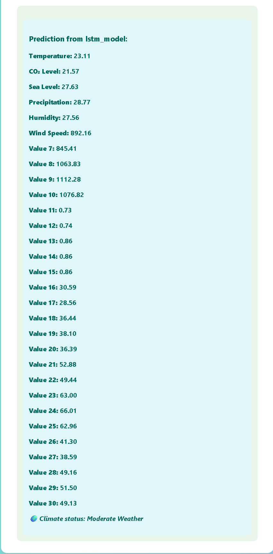
Screenshot of Output:

Slide 9
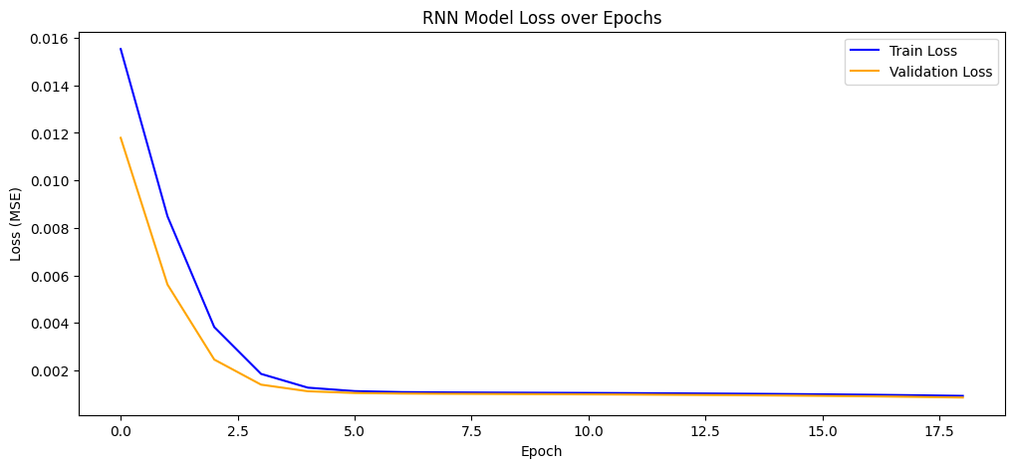
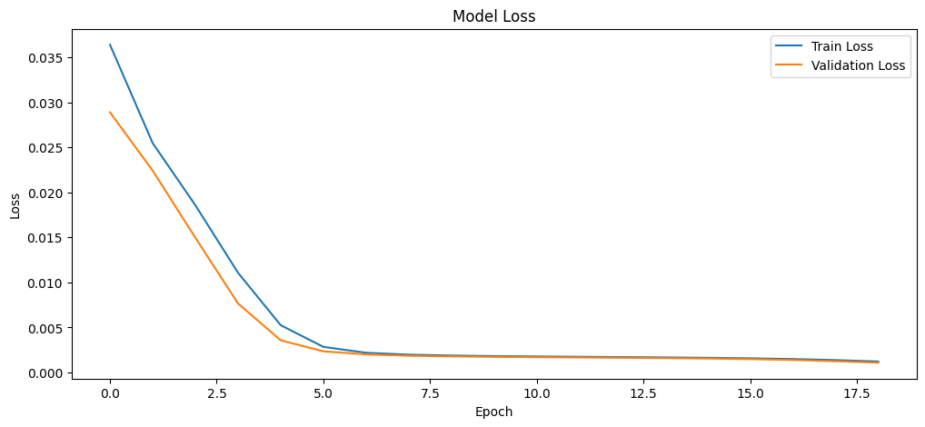
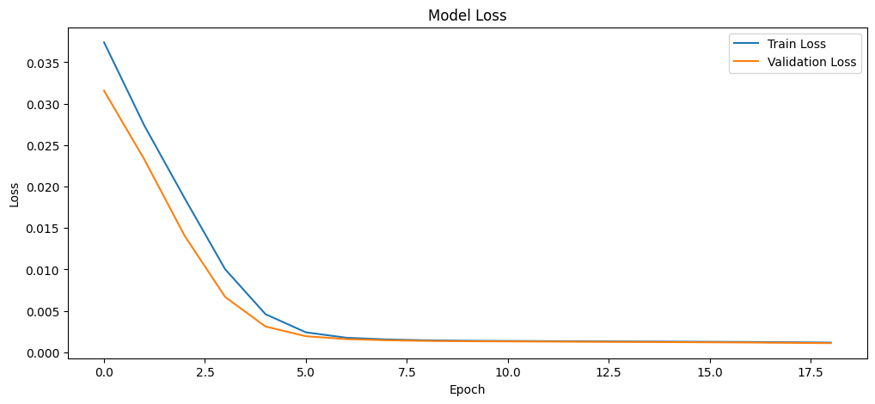
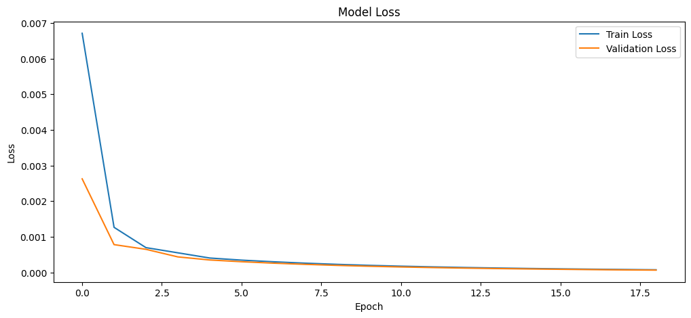
Models Training and Testing Performance
RNN
LSTM
GRU
ANN

Slide 10
Conclusion:
The AI-Powered Climate Change Predictor effectively leverages machine learning to analyze historical climate patterns and forecast future changes. This project showcases how technology can play a vital role in combating climate change by enabling proactive planning and environmental conservation. With further enhancement and real-time integration, this system can become an invaluable tool for governments, researchers, and environmentalists.

